Slide 1
INFO 7390 Advances in Data Sciences and Architecture Statistics and Probability
Nik Bear Brown
nikbearbrown@gmail.com

Slide 2

Probability and Statistics

Slide 3
Probability
Probability is the measure of the likelihood that an event will occur.
0
1.0
0.5
The occurrence of the event is just as likely as it is unlikely

Slide 4
Probability
Probability is a measure of the likelihood of a random phenomenon or chance behavior. Probability describes the long-term proportion with which a certain outcome will occur in situations with short-term uncertainty.
Probability is expressed in numbers between 0 and 1. Probability = 0 means the event never happens; probability = 1 means it always happens.
The total probability of all possible event always sums to 1.

Slide 5
Probability
The probability of an event equals the number of times it happens divided by the number of opportunities.
These numbers can be determined by experiment or by knowledge of the system.
For instance, rolling a die (singular of dice). The chance of rolling a 2 is 1/6, because there is a 2 on one face and a total of 6 faces. So, assuming the die is balanced, a 2 will come up 1 time in 6.
It is also possible to determine probability by experiment: if the die were unbalanced (loaded = cheating), you could roll it hundreds or thousands of times to get the actual probability of getting a 2. For a fair die, the experimentally determined number should be quite close to 1/6, especially with many rolls.
0.5

Slide 6
Assigning Probabilities
Classical approach: make certain assumptions (such as equally likely, independence) about situation.
Relative frequency: assigning probabilities based on experimentation or historical data.
Subjective approach: Assigning probabilities based on the assignor’s judgment. [Bayesian]
0.5

Slide 7
Sample Space
Coin Toss ={head,tail}
Two coins S = {HH, HT, TH, TT}
Inspecting a part ={good,bad}
Rolling a die S ={1,2,3,4,5,6}

Slide 8
Probability
The probability of any event E, P(E), must be between 0 and 1 inclusive. That is,
0 < P(E) < 1.
2. If an event is impossible, the probability of the event is 0.
3. If an event is a certainty, the probability of the event is 1.
4. If S = {e₁, e₂, …, e_{n}}, then
P(e₁) + P(e₂) + … + P(e_{n}) = 1.

Slide 9
Unions and Intersections
AND Rule of Probability
The probability of 2 independent events both happening is the product of their individual probabilities.
Called the AND rule because “this event happens AND that event happens”.
For example, what is the probability of rolling a 2 on one die and a 2 on a second die? For each event, the probability is 1/6, so the probability of both happening is 1/6 x 1/6 = 1/36.
Note that the events have to be independent.

Slide 10
Probability - The OR Rule of Probability
The probability that either one of 2 different events will occur is the sum of their separate probabilities.
For example, the chance of rolling either a 2 or a 3 on a die is 1/6 + 1/6 = 1/3.

Slide 11
Joint Probability
For events A and B, joint probability Pr(AB) stands for the probability that both events happen.
Example: A={HH}, B={HT, TH}, what is the joint probability Pr(AB)?

Slide 12
Independence
Two events A and B are independent in case
Pr(AB) = Pr(A)Pr(B)
A set of events {A_{i}} is independent in case

Slide 13
Conditional Probability
If A and B are events with Pr(A) > 0, the conditional probability of B given A is

Slide 14
Mutually Exclusive Events
The OR Rule of Probability
Mutually exclusive events-no outcomes from S in common
A ∩ Β = ∅
S
A
B

Slide 15
Probability - The OR Rule of Probability
The probability that either one of 2 different events will occur is the sum of their separate probabilities.
For example, the chance of rolling either a 2 or a 3 on a die is 1/6 + 1/6 = 1/3.

Slide 16
Probability - NOT Rule
The chance of an event not happening is 1 minus the chance of it happening.
For example, the chance of not getting a 2 on a die is 1 - 1/6 = 5/6.
This rule can be very useful. Sometimes complicated problems are greatly simplified by examining them backwards.
P(A’ ) = 1 - P(A)
For an event A, A’ is the complement of A; A’ is everything in S that is not in A.
A'
A

Slide 17
Probability
if A and B are mutually exclusive events:
P(A or B) = P(A) + P(B)
ex., die roll: P(1 or 6) = 1/6 + 1/6 = .33
possibility set:
sum of all possible outcomes
~A = anything other than A
P(A or ~A) = P(A) + P(~A) = 1

Slide 18
Probability
one event has no influence on the outcome of another event
if events A & B are independent
then P(A&B) = P(A)*P(B)
if P(A&B) = P(A)*P(B)
then events A & B are independent
coin flipping
if P(H) = P(T) = .5 then
P(HTHTH) = P(HHHHH) =
.5*.5*.5*.5*.5 = .5⁵ = .03

Slide 19
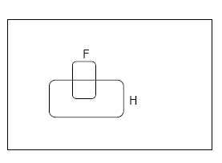
Conditional Probability
P(F|H) = Fraction of worlds in which H is true that also have F true

Slide 20
The Axioms of Probability
0 <= P(A) <= 1
P(True) = 1
P(False) = 0
P(A or B) = P(A) + P(B) - P(A and B)
Where do these axioms come from? Were they “discovered”?
Answers coming up later.

Slide 21
Theorems from the Axioms
0 <= P(A) <= 1, P(True) = 1, P(False) = 0
P(A or B) = P(A) + P(B) - P(A and B)
From these we can prove:
P(not A) = P(~A) = 1-P(A)

Slide 22
Another important theorem
0 <= P(A) <= 1, P(True) = 1, P(False) = 0
P(A or B) = P(A) + P(B) - P(A and B)
From these we can prove:
P(A) = P(A ^ B) + P(A ^ ~B)

Slide 23
Multivalued Random Variables
Suppose A can take on more than 2 values
A is a random variable with arity k if it can take on exactly one value out of {v₁,v₂, .. v_{k}}
Thus…

Slide 24

The Monty Hall Problem

Slide 25
About Let’s Make a Deal
Let’s Make a Deal was a game show hosted by Monty Hall and Carol Merril. It originally ran from 1963 to 1977 on network TV.
The highlight of the show was the “Big Deal,” where contestants would trade previous winnings for the chance to choose one of three doors and take whatever was behind it--maybe a car, maybe livestock.
Let’s Make a Deal inspired a probability problem that can confuse and anger the best mathematicians, even Paul Erdös.

Slide 26

Suppose you’re a contestant on Let’s Make a Deal.

Slide 27

You are asked to choose one of three doors.
The grand prize is behind one of the doors;
The other doors hide silly consolation gifts which Monty called “zonks”.

Slide 28

You choose a door.
Monty, who knows what’s behind each of the doors,
reveals a zonk behind one of the other doors.
He then gives you the option of switching doors or
sticking with your original choice.

Slide 29
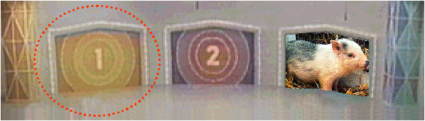

You choose a door.
Monty, who knows what’s behind each of the doors,
reveals a zonk behind one of the other doors.
He then gives you the option of switching doors or
sticking with your original choice.
The question is: should you switch?

Slide 30
The answer is yes, you should switch!
Assuming that Monty always gives you
a chance to switch, you double your odds
of winning by switching doors.
We will see why, first by enumerating the possible cases, then by directly computing the probability of winning with each strategy.

Slide 31
Each door has a 1 in 3 chance of hiding the grand prize.
Suppose we begin by choosing door #1.
$
$
$

Slide 32

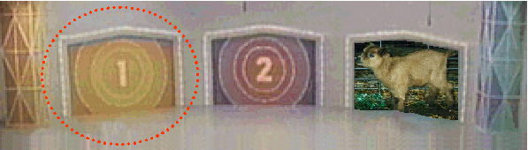

Each door has a 1 in 3 chance of hiding the grand prize.
Suppose we begin by choosing door #1.
In this case Monty may
open either door #2 or
#3
$
$
In both of these cases,
Monty is forced to reveal
the only other zonk.
$

Slide 33
So what happens when you switch?
In this case you were
right the first time.
You lose!
$
$
In both of these cases,
you switch to the correct
door.
You win!
$

Slide 34
To prove this result without listing all the cases, we need the notion of conditional probability.
Conditional probability gives us a way to determine how the occurrence of one event affects the probability of another.
Here, if we’ve chosen door #1 and Monty has opened door #2, we’d like to know the probability that the prize is behind door #1 and the probability that the prize is behind door #3 given this additional information.

Slide 35
We can determine these probabilities using the rule
In words: The probability of event A given event B is the probability of both A and B divided by the probability of B.

Slide 36
In the following argument:
Assume that:
we originally chose door #1.
Monty opened door #2.
Notation
Let “#1” denote the event that the prize is behind door #1, and similarly for doors #2 and #3.
Let “opened #2” denote the event that Monty has opened door #2.
Our aim is to compute p(#1 | opened #2) and p(#3 | opened #2).

Slide 37
(By rule 2.)
(If the prize is behind door #1, Monty can open either #2 or #3.)
(By rule 2.)
(If the prize is behind door #3, Monty must open door #2.)

Slide 38
So:
and

Slide 39
Bayes' Theorem
P(A|B) = P(B|A) P(A)/
P(B)
P(A) – the PRIOR PROBABILITY – represents your knowledge about A before you have gathered data.

Slide 40
Bayes' Theorem
P(A|B) = P(A&B)/
P(B)
P(B|A) = P(A&B)/
P(A)
so
P(A|B) = P(B|A) P(A)/
P(B)

Slide 41
Bayes Example
Mode of transport: Probability late:
Uber 50%
Bus 20%
Train 1%
Suppose that Bear is late.
His boss wishes to estimate the probability that he traveled to work that day by Uber.
He does not know which mode of transportation Bob usually uses, so he gives a prior probability of 1 in 3 to each of the three possibilities.

Slide 42
Bayes Example
P(A|B) = P(B|A) P(A) / P(B)
P(Uber|late) = P(late| Uber) x P(Uber) / P(late)
P(late| Uber) = 0.5 (he will be late half the time he drives)
P(Uber) = 0.33 (this is the boss' assumption)
P(late) = 0.5 x 0.33 + 0.2 x 0.33 + 0.01 x 0.33
(all the probabilities that he will be late added together)
P(Uber |late) = 0.5 x 0.33 / 0.5 x 0.33 + 0.2 x 0.33 + 0.01 x 0.33
= 0.165 / 0.71 x 0.33
= 0.7042

Slide 43
Application of Bayes’ Theorem
Consider a manufacturing firm that receives shipment of parts from two suppliers.
Let A₁ denote the event that a part is received from supplier 1; A₂ is the event the part is received from supplier 2
We get 65 percent of our parts from supplier 1 and 35 percent from supplier 2.
P(A₁) = .65 and P(A₂) = .35

Slide 44
Quality levels differ between suppliers
 | Percentage Good Parts | Percentage Bad Parts
Supplier 1 | 98 | 2
Supplier 2 | 95 | 5
Let G denote that a part is good and B denote the event that a part is bad. Thus we have the following conditional probabilities:
P(G | A₁ ) = .98 and P(B | A₂ ) = .02
P(G | A₂ ) = .95 and P(B | A₂ ) = .05

Slide 45
Tree Diagram for Two-Supplier Example
Step 2 Condition
Experimental Outcome
Step 1 Supplier
(A₁, G)
G
A₁
B
(A₁, B)
A₂
G
(A₂, G)
B
(A₂, B)

Slide 46
Each of the experimental outcomes is the intersection of 2 events.
For example, the probability of selecting a part from supplier 1
that is good is given by:

Slide 47
Probability Tree for Two-Supplier Example
Step 2 Condition
Step 1 Supplier
Probability of Outcome
P(G | A₁)
.98
P(A₁)
P(B | A₂)
.65
.02
P(B | A₂)
P(A₂)
.95
.35
P(B | A₂)
.05

Slide 48
A bad part broke one of our machines—so we’re through for the day.
What is the probability the part came from suppler 1?
We know from the law of conditional probability that:
(4.14)
Observe from the probability tree that:
(4.15)

Slide 49
The probability of selecting a bad part is found by adding together
the probability of selecting a bad part from supplier 1 and the
probability of selecting bad part from supplier 2.
That is:
(4.16)

Slide 50
Bayes’ Theorem for 2 events
By substituting equations (4.15) and (4.16) into (4.14), and writing a similar result for P(B | A₂), we obtain Bayes’ theorem for the 2 event case:

Slide 51
Bayes Math

Slide 52
Bayes’ Theorem

Slide 53
Tabular Approach to Bayes’ Theorem— 2-Supplier Problem
(1) Events A_{i} | (2) Prior Probabilities P(A_{i}) | (3) Conditional Probabilities P(B | A₁ ) | (4) Joint Probabilities P(A_{i} ∩ B) | (5) Posterior Probabilities P(A_{i} | B)
A₁ | .65 | .02 | .0130 | .0130/.0305=.4262
A₂ | .35 | .05 | .0175 | .0175/.0305 =.5738
 | 1.00 |  | P(B)=.0305 | 1.0000

Slide 54
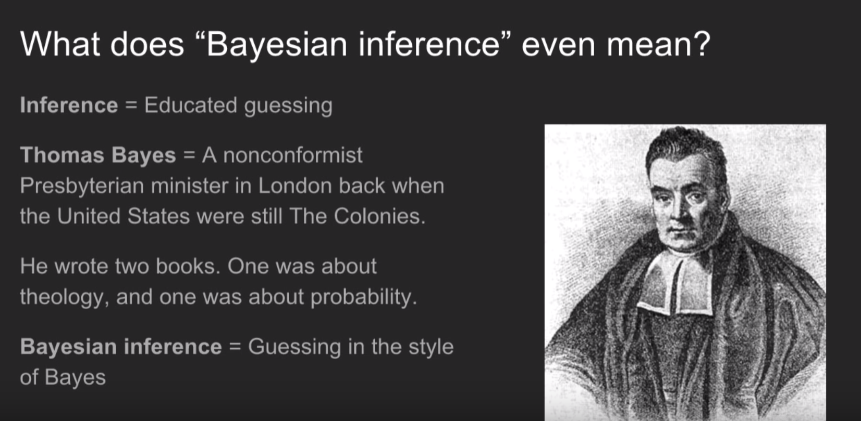
How Bayes Theorem works
How Bayes Theorem works https://youtu.be/5NMxiOGL39M

Slide 55
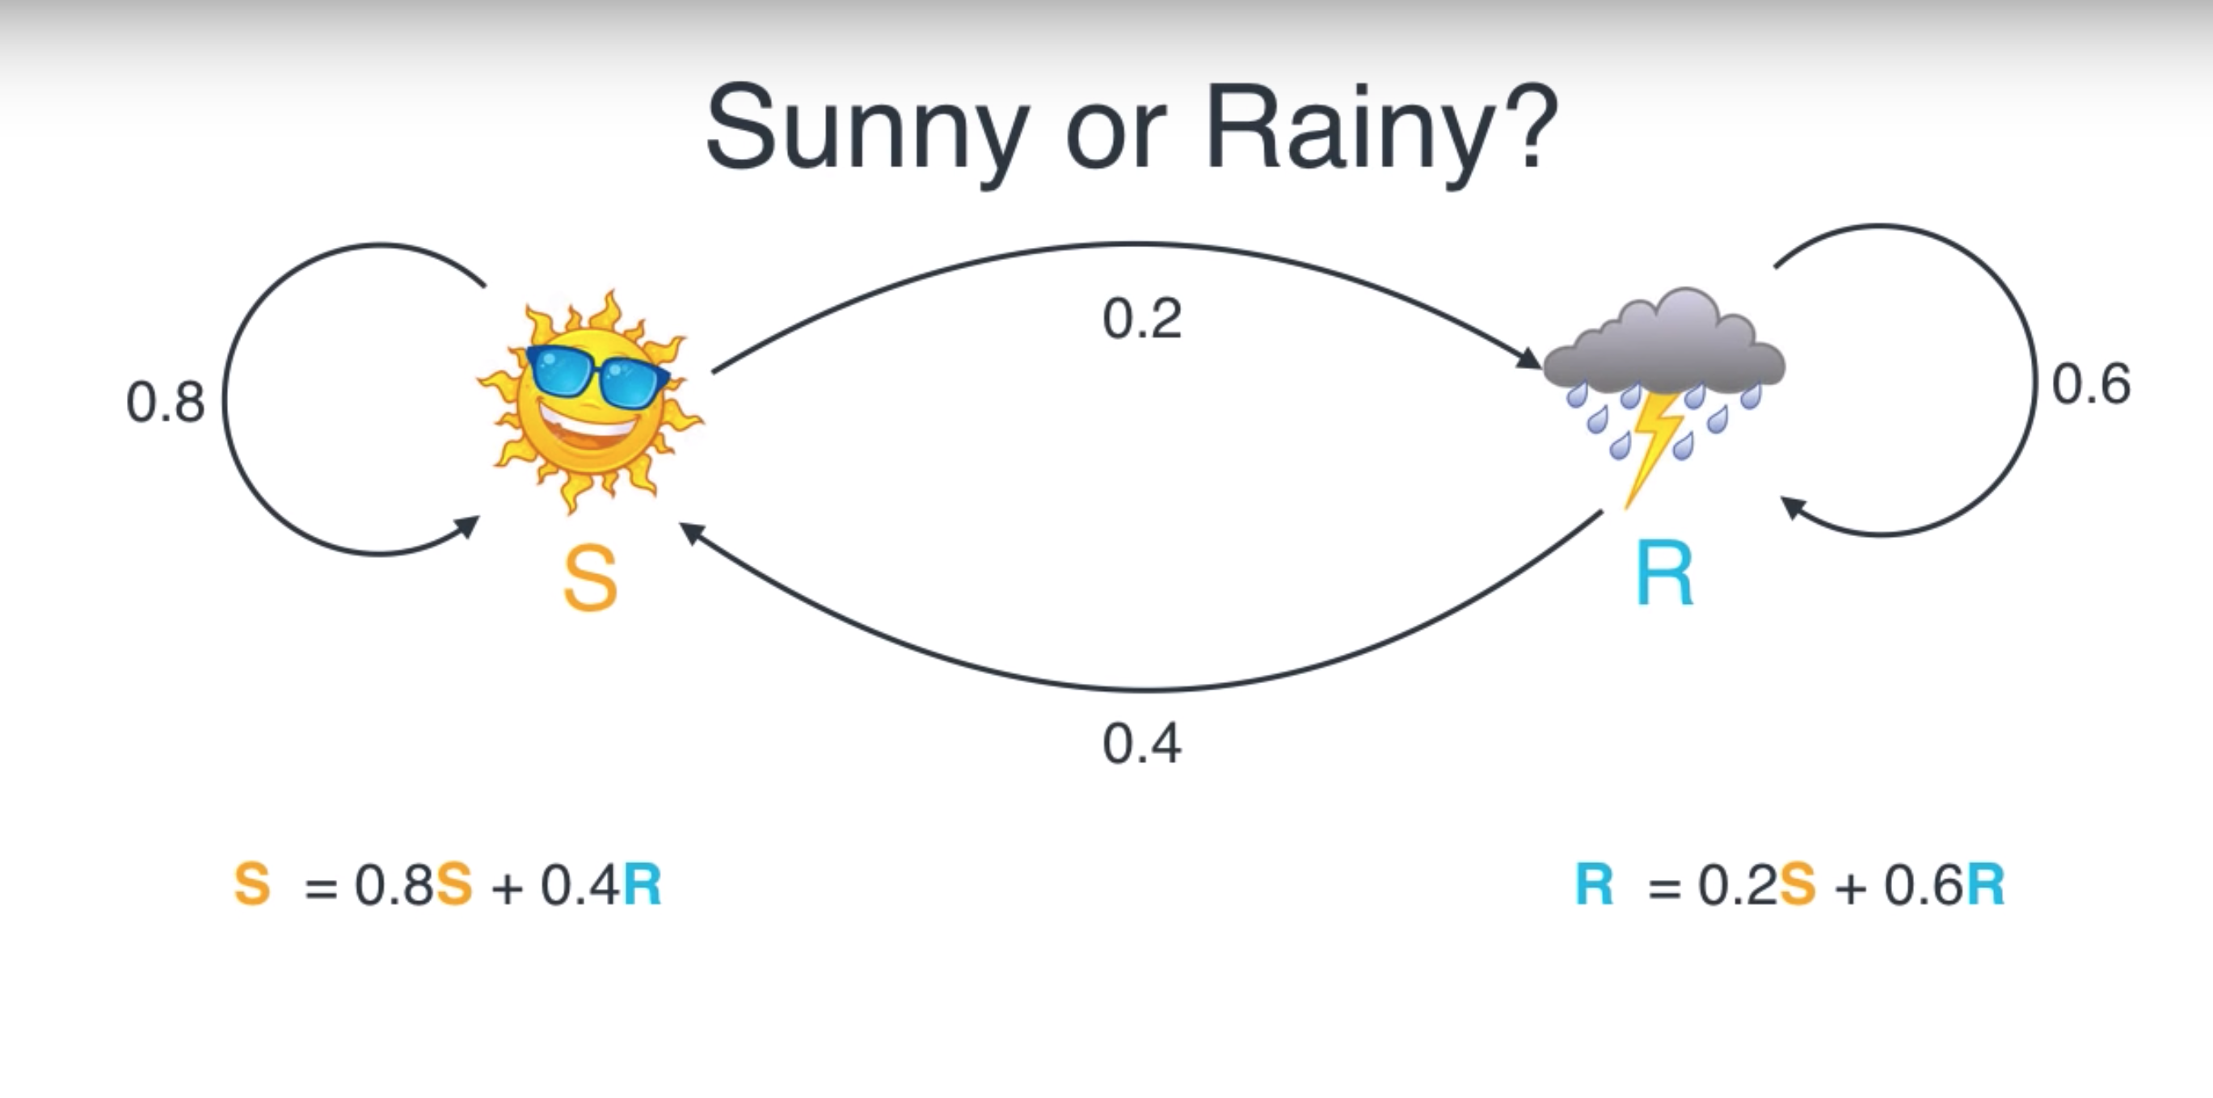
Bayes Theorem and Hidden Markov Models
Bayes Theorem and Hidden Markov Models https://youtu.be/kqSzLo9fenk

Slide 56
A note about independence
Assume A and B are Boolean Random Variables. Then
“A and B are independent”
if and only if
P(A|B) = P(A)
“A and B are independent” is often notated as
Notes:
Before we discuss how to evaluate a density estimator, we need to understand the concept of independence

Slide 57
Independence Theorems
Assume P(A|B) = P(A)
Then P(A^B) =
= P(A) P(B)
Assume P(A|B) = P(A)
Then P(B|A) =
= P(B)

Slide 58
Independence Theorems
Assume P(A|B) = P(A)
Then P(~A|B) =
= P(~A)
Assume P(A|B) = P(A)
Then P(A|~B) =
= P(A)

Slide 59
Multivalued Independence
For multivalued Random Variables A and B,
if and only if
from which you can then prove things like…

Slide 60
Evaluating a Density Estimator
Given a record x, a density estimator M can tell you how likely the record is:
Given a dataset with R records, a density estimator can tell you how likely the dataset is:
(Under the assumption that all records were independently generated from the Density Estimator’s JD)
Notes:
What is M???? -- the the joint density table that we learned from the table!

Slide 61
Log Probabilities
Since probabilities of datasets get so small we usually use log probabilities
Notes:
16 > 4
Log 16 > log 4

Slide 62
Probability Trees [Decision Trees]…
A probability tree is a simple and effective method of applying the probability rules by representing events in an experiment by lines. The resulting figure resembles a tree.
First selection
Second selection
P(F|F) = 2/9
P(F) = 3/10
P( M|F) = 7/9
P(F|M) = 3/9
P( M) = 7/10
P( M|M) = 6/9

Slide 63
Probability Trees…
At the ends of the “branches”, we calculate joint probabilities as the product of the individual probabilities on the preceding branches.
Sample Space:[F₁*F₂, F₁*M₂, M₁*F₂, M₁*M₂]
Joint probabilities
First selection
Second selection
P(FF)=(3/10)(2/9)
P(F|F) = 2/9
P(F) = 3/10
P( M|F) = 7/9
P(FM)=(3/10)(7/9)
P(F|M) = 3/9
P(MF)=(7/10)(3/9)
P( M) = 7/10
P( M|M) = 6/9
P(MM)=(7/10)(6/9)

Slide 64
Random variables
Random variables assign a real number to each
outcome:
Random variables can be:
Discrete: if it takes at most countably many
values (integers).
Continuous: if it can take any real number.

Slide 65
Random variables
Distribution of a random variable
(i) when
(ii) when
is nondecreasing.
is right-continuous.
when

Slide 66
Random variables
For a random variable, we define
Probability function
Density function,
depending on whether it is discrete or continuous

Slide 67
Random variables
Probability function
verifies

Slide 68
Random variables
Probability density function
verifies
We have
RANDOM VARIABLES
68

Slide 69
Random variables
completely determines the distribution
of a random variable.

Slide 70
Discrete Random Variables
Random variables (RVs) which may take on only a countable number of distinct values
E.g. the total number of tails X you get if you flip 100 coins
X is a RV with arity k if it can take on exactly one value out of {x₁, …, x_{k}}
E.g. the possible values that X can take on are 0, 1, 2, …, 100

Slide 71
Probability of Discrete RV
Probability mass function (pmf): P(X = x_{i})
Easy facts about pmf
Σ_{i} P(X = x_{i}) = 1
P(X = x_{i}∩X = x_{j}) = 0 if i ≠ j
P(X = x_{i} U X = x_{j}) = P(X = x_{i}) + P(X = x_{j}) if i ≠ j
P(X = x₁ U X = x₂ U … U X = x_{k}) = 1

Slide 72
Continuous Random Variables
Probability density function (pdf) instead of probability mass function (pmf)
A pdf is any function f(x) that describes the probability density in terms of the input variable x.

Slide 73
Probability of Continuous RV
Properties of pdf
Actual probability can be obtained by taking the integral of pdf
E.g. the probability of X being between 0 and 1 is

Slide 74
Random variables
Bernoulli
p
1-p
p
1-p
0 1
0 1

Slide 75
Random variables
Binomial
Successes in n independent Bernoulli trials with
success probability p

Slide 76
Random variables
Geometric
Time of first success in a sequence of independent
Bernoulli trials with success probability p

Slide 77
Random variables
Poisson
X expresses the number of “ rare events”

Slide 78
Random variables
Uniform
F(x)
f(x)
a b
a b
RANDOM VARIABLES
78

Slide 79
Random variables
Exponential
1/β
1
F(x)
f(x)
0 β
RANDOM VARIABLES

Slide 80
Random variables
Normal
f(x)
F(x)
μ

Slide 81
Random variables
Properties of normal distribution
standard normal
(ii)
(iii) independent i=1,2,...,n

Slide 82
Random variables
Two random variables X and Y are independent if
and only if:
for all values x and y.

Slide 83
Random variables
Discrete variables
Continuous variables
If X and Y are independent:
RANDOM VARIABLES

Slide 84
Random variables
Properties:
(i)
If are independent then:

Slide 85
Random variables
Moment of order k

Slide 86
Random variables
Variance
Given X with :
standard deviation

Slide 87
Permutations
A B C D E
How many ways can we choose 2 letters from the above 5, without replacement, when the order in which we choose the letters is important?
5 × 4 = 20

Slide 88
Permutations (cont.)

Slide 89
Combinations
A B C D E
How many ways can we choose 2 letters from the above 5, without replacement, when the order in which we choose the letters is not important?
5 × 4 = 20 when order important
Divide by 2: (5 × 4)/2 = 10 ways
N choose K (5 choose 2)

Slide 90
Bounding Numbers of Combinations
= number of (unordered) combinations of n objects taken k at a time
N choose K

Slide 91
Combinations (cont.)

Slide 92
Tail Bounds
In the analysis of randomized algorithms, we need to know how much does an algorithms run-time/cost deviate from its expected run-time/cost.
That is we need to find an upper bound on Pr[X deviates from E[X] a lot]. This we refer to as the tail bound on X.

Slide 93
Markov and Chebychev Inequalities
Markov Inequality (uses only mean)
Chebychev Inequality (uses mean and variance)

Slide 94
Markov and Chebychev Inequalities
Example, if B is a Binomial with parameters n,p

Slide 95

Chernoff bounds
The Chernoff bound for a random variable X is
obtained as follows: for any t >0,
Pr[X  a] = Pr[e^{tX}  e^{ta}] ≤ E[e^{tX} ] / e^{ta}
Similarly, for any t <0,
Pr[X  a] = Pr[e^{tX}  e^{ta}] ≤ E[e^{tX} ] / e^{ta}
The value of t that minimizes E[e^{tX} ] / e^{ta} gives the best possible bounds.

Slide 96
Chernoff Bound of Random Variable A
Uses all moments
Uses moment generating function
By setting x = γ’ (s) 1st derivative minimizes bounds

Slide 97
Chernoff Bound of Discrete Random Variable A
Choose z = z₀ to minimize above bound
Need Probability Generating function

Slide 98
Chernoff Bounds for Binomial B with parameters n,p
Above mean x ≥ μ

Slide 99
Chernoff Bounds for Binomial B with parameters n,p
Below mean x ≤ μ

Slide 100
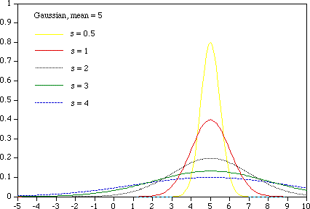
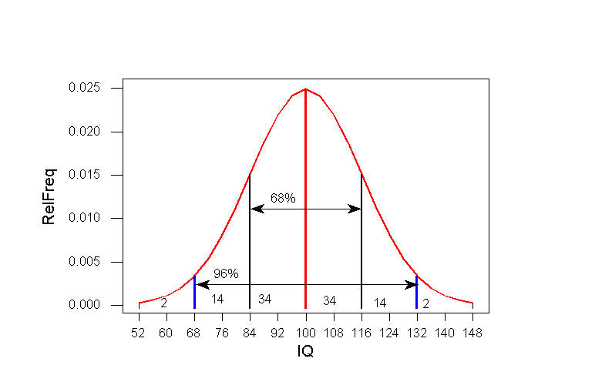
The Normal Distribution (Han & Kamber, 2006)

Slide 101
The Binomial Distribution (Han & Kamber, 2006)
coin with Pr[heads] = p, flip n times
probability of getting exactly k heads:
choose(n,k) p^{k}(1-p)^{n-k}
for large n and p fixed:
approximated well by a normal with
m = np, s = sqrt(np(1-p))
s/m → 0 as n grows

Slide 102
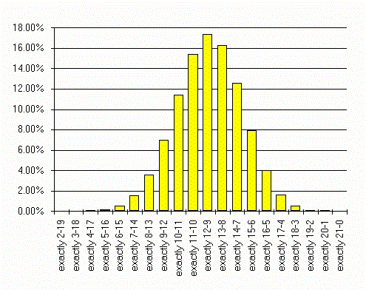
The Binomial Distribution (Han & Kamber, 2006)
www.professionalgambler.com/ binomial.html
Notes:
Say you have a 57.5% chance of winning each and every bet. How many winners can you expect in the next 21 bets?
57.5% of 21 is 12.075, so you can expect a win loss record of 12-9
But this is not the only thing that can happen, several other outcomes are very likely. The graph shows the binomial distribution of all possible outcomes.
Although 12-9 is the most “likely” is will occur only slightly more than 17% of the time. That’s about 1 in 6 so in real life you can figure you’ll get an outcome other than 12-9 about 5 of 6 times.

Slide 103
The Poisson Distribution (Han & Kamber, 2006)
like binomial, applies to variables taking on integer values > 0
often used to model counts of events
number of phone calls placed in a given time period
number of times a neuron fires in a given time period
single free parameter l
probability of exactly x events:
exp(-l) l^{x}/x!
mean and variance are both l
binomial distribution with n large, p = l/n (l fixed)
converges to Poisson with mean l

Slide 104
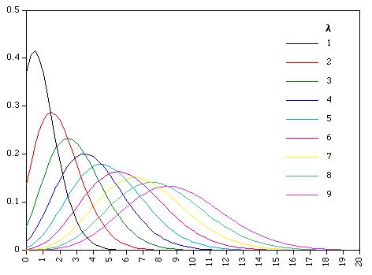
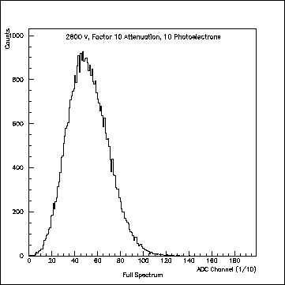
The Poisson Distribution (Han & Kamber, 2006)
single photoelectron distribution

Slide 105
Fat-Tailed Distributions
Power law distributions:
for variables assuming integer values > 0
Prob [X=k] ~ Ck^{-α}
typically 0 < alpha < 2; smaller a gives heavier tail
For binomial, normal, and Poisson distributions the tail probabilities approach 0 exponentially fast
What kind of phenomena does this distribution model?
What kind of process would generate it?

Slide 106
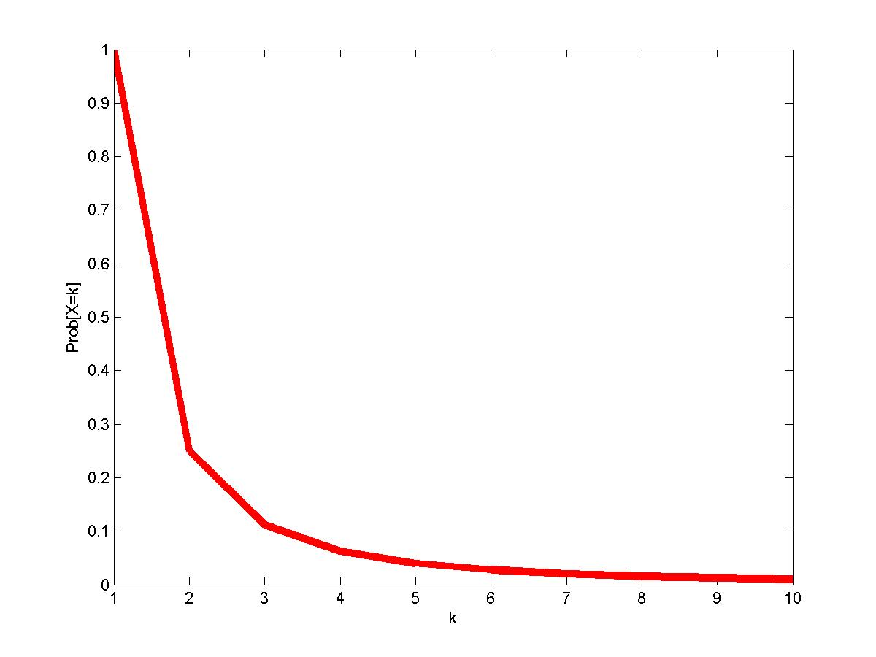
Power Law: Prob [X=k] = k⁻²

Slide 107
Power Law
Prob [X=k] ~ Ck^{-α}
log Prob [X=k] ~ log C –α log k
Prob [X=k] = k⁻²
log Prob [X=k] = -2 log k

Slide 108
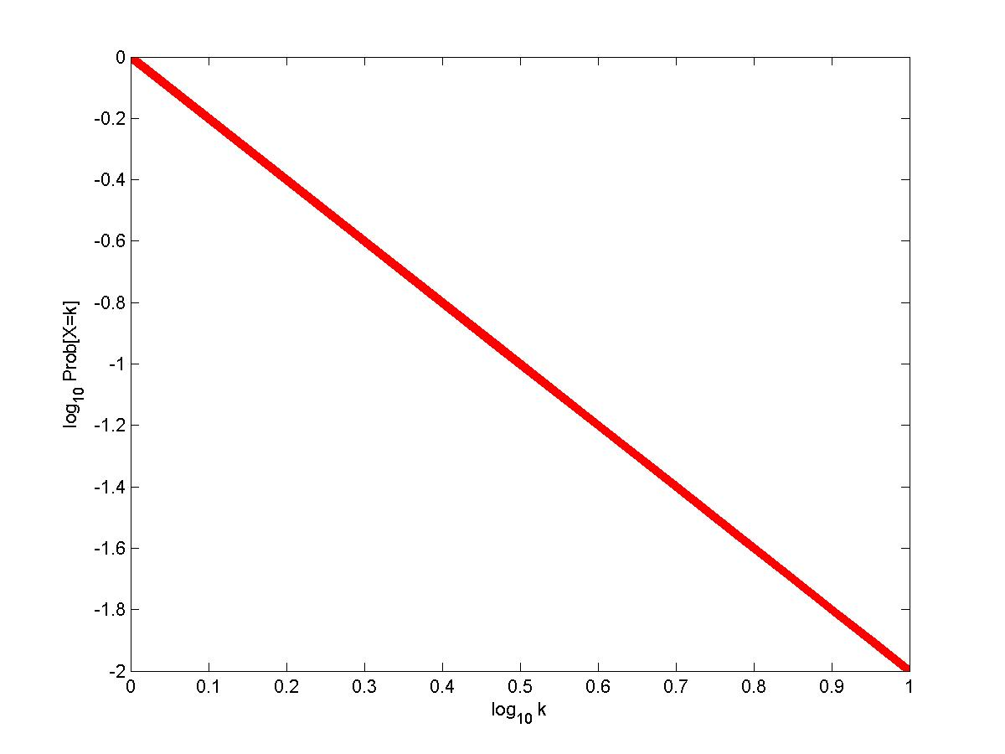
Power Law: Log-Log plot

Slide 109
Power Law contd.
More general definition:
Prob [X≥k] ~ Ck^{-α}
Particularly useful if X takes on real values.
Sometimes referred to as “heavy tailed” or “scale free.”

Slide 110
Power Laws in Degree distribution
Let G be a graph.
Let X_{k} be the proportion of nodes with degree k in G.
Then if X_{k} ~ Ck^{-α}
we say that G has power law degree distribution.

Slide 111
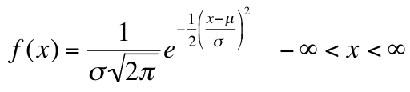
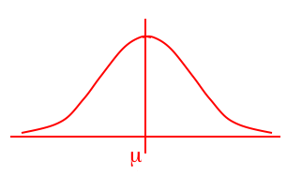
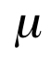
The Normal Distribution
The normal distribution is the most important of all probability distributions. The probability density function of a normal random variable is given by:
It looks like this:
Bell shaped,
Symmetrical around the mean …

Slide 112
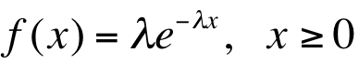
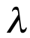
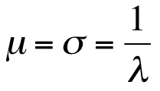
Exponential Distribution
Another important continuous distribution is the exponential distribution which has this probability density function:
Note that x ≥ 0. Time (for example) is a non-negative quantity; the exponential distribution is often used for time related phenomena such as the length of time between phone calls or between parts arriving at an assembly station. Note also that the mean and standard deviation are equal to each other and to the inverse of the parameter of the distribution (lambda )

Slide 113
Poisson Distribution
Distribution often used to model the number of incidences of some characteristic in time or space:
Arrivals of customers in a queue
Numbers of flaws in a roll of fabric
Number of typos per page of text.
Distribution obtained as follows:
Break down the “area” into many small “pieces” (n pieces)
Each “piece” can have only 0 or 1 occurrences (p=P(1))
Let λ=np ≡ Average number of occurrences over “area”
Y ≡ # occurrences in “area” is sum of 0^{s} & 1^{s} over “pieces”
Y ~ Bin(n,p) with p = λ/n
Take limit of Binomial Distribution as n →∞ with p = λ/n

Slide 114
Negative Binomial Distribution
Used to model the number of trials needed until the r^{th} Success (extension of Geometric distribution)
Based on there being r-1 Successes in first y-1 trials, followed by a Success

Slide 115
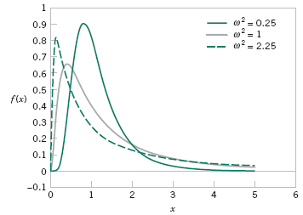
Lognormal Distribution

